Slide 1
To-Do List App in GoLang

Slide 2
Team members -
Ankita Singh - asingh63@uncc.edu
Bhargavi Lata Mugata - bmugata@uncc.edu
Dhruvil Patel - dpate172@uncc.edu
Mounica Arendala - marendal@uncc.edu
Sneh Jain - sjain42@uncc.edu
Varun Jain - vjain10@uncc.edu

Slide 3
Project Description
According to a research, in an eight-hour workday, the average worker is only productive for two hours and 53 minutes. Yep, in an 8-hour workday, we only end up working for a maximum of 3 hours on average. It’s a disaster!
So we end up searching on the internet- from productivity books to techniques, to meditation-trying our hand at everything under the sun to be more productive. While looking for newer ways and techniques to improve productivity, we often forget the age-old trick to get work done quickly- a to-do list.

Slide 4
Project Description
A to-do list application is an organized way of maintaining the tasks you need to complete instead of relying on your memory.
This application helps you prioritize your task and gives you an action plan for the day. In this way, you always know what you need to do.
Planning your day with a to-do list helps you know exactly what you are doing, and what you need to do.

Slide 5
Why is To-Do list Important?
To-do lists help you to keep track of your personal tasks as well as professional work.
It’s a great way to ensure that you’re making strides towards your daily and weekly goals without keeping everything in your brain.
If you don’t have a to-do list ready, you’re likely to miss out on major tasks and will keep wondering where did your time go!
In this way, you can make sure that you complete all the priority tasks first and not get distracted by not-so-important tasks.
This eliminates all the guesswork from your workflow and prevents you from straying away and wasting time just because you have no idea what to focus on next!

Slide 6
Features & Prerequisites:
Performing CRUD(Create,Read, Update,Delete) operations on to-do items.
Improvise the database management in efficient way.
DataBase Auto migration feature, where it will create a database table based on struct definition in the code.
Prerequisites:
Golang installed on your system
A basic knowledge of Golang and jQuery

Slide 7
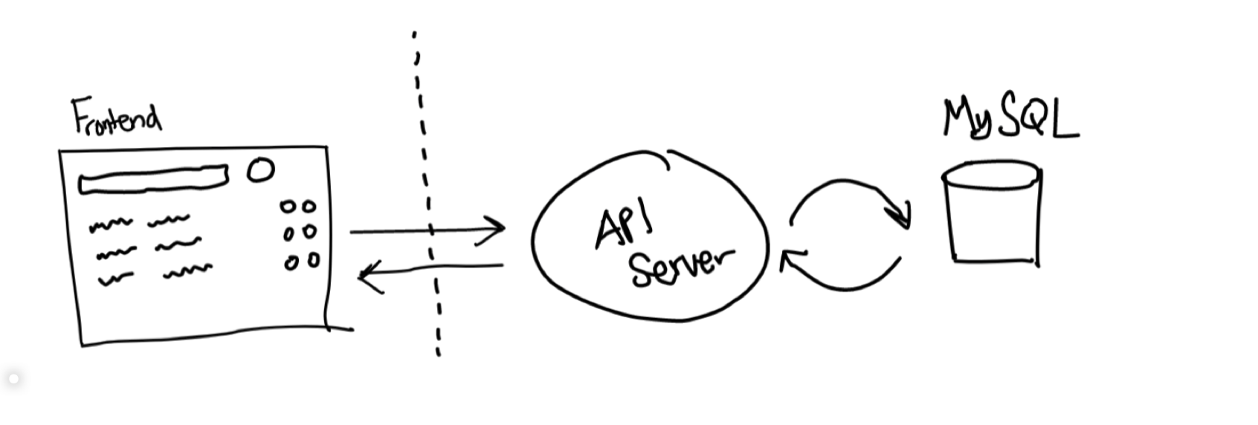
WorkFlow:

Slide 8
WorkFlow Description:
We’ll be building what’s on the right side of the diagram. The specifications for our API Server are:
It listens to port 8000 on the localhost.
It has five endpoints: healthz, createItem, getCompletedItem, getIncompleteItems, updateItem, and deleteItem.
The TodoItem model consists of id, description and completed status attributes.

Slide 9
Golang Intro
It is a compiled language, fast and high-performance language intended to be simple and is designed to be easy to read and understand.
Go was created at Google by Rob Pike, Robert Griesemer and Ken Thompson, and it first appeared in Nov 2009.
The syntax of Golang is designed to be highly clean and accessible.
Go was invented at such a time when multicore CPU architectures were common everywhere, and no programming language simplified the development of multithreaded applications

Slide 10
Golang Intro
Golang is a very efficient language, just like C/C++, handling parallelisms like Java, and has easy code readability like Python and pearl.
Golang has indisputable architectural advantages over its predecessors.
Go is used by some of the big brands such as BBC, Uber, Novartis, Basecamp, and Soundcloud.
Uber has reported better throughput, high performance, latency, and uptime. BBC, the house name in broadcasting the world news, uses it for backend, including crawlers and web scrapers.

Slide 11
Golang Intro
Top Characteristics of Go Lang :-
Open-Source
Static typing
Concurrency support
Powerful Standard Library and Tool Set
Garbage Collection
Testing Capabilities
Advantages such as
Ease of use
Cross-Platform Development Opportunities
Faster Compilation and Execution
Scalable
Time Saving

Slide 12
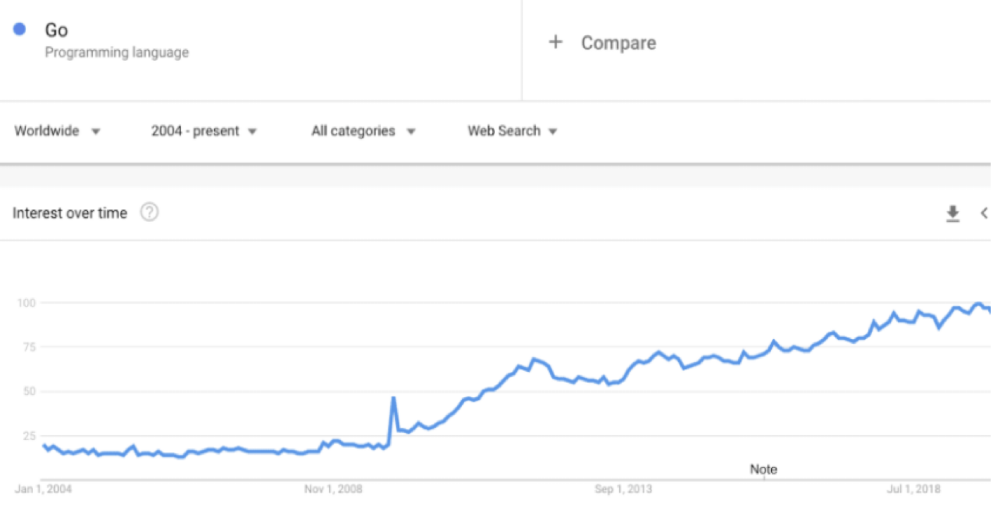
Golang trends
Below is the Google trends overview of the Go programming language. It is up and growing steadily.

Slide 13
Why Go?
It is effortless to learn for programmers with C++ experience, and also converting legacy code to Go is pretty straightforward and fairly simple.
Being a compiled, statically typed language, it’s much faster than interpreted options and also offers most of the performance benefits.
Go as a language is more similar to C, however in addition to C features, Go offers memory safety, garbage collection, structural typing, and CSP-Style concurrency.
In the recent StackOverflow 2020 survey results, it is found that Go is one of the most loved and wanted programming languages among developers.

Slide 14
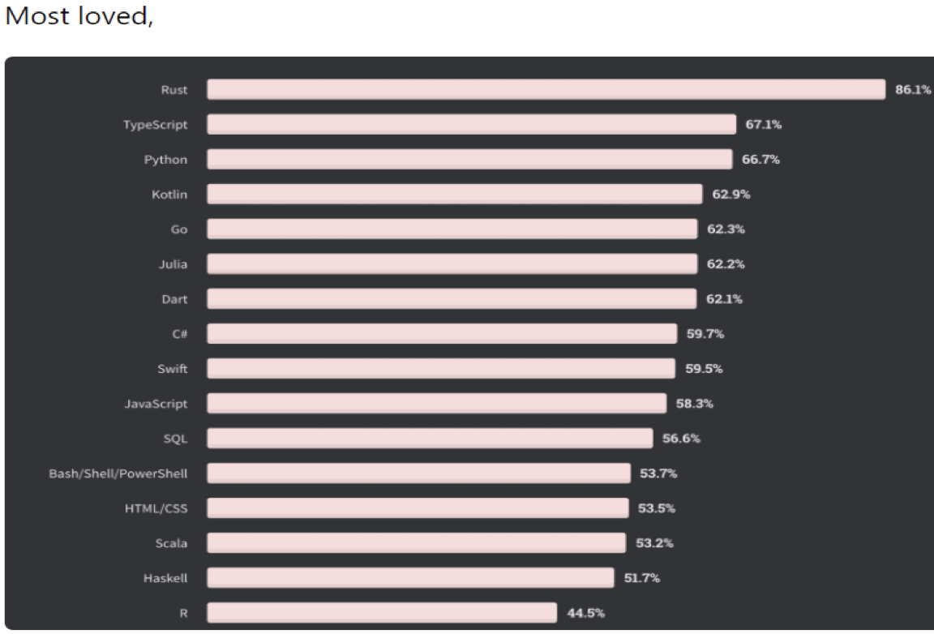

Slide 15
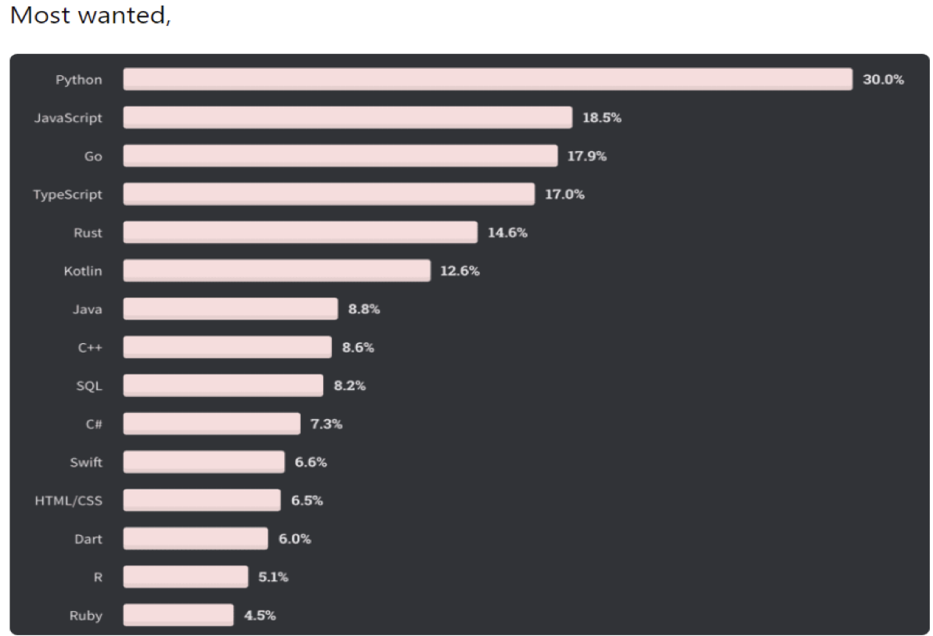

Slide 16
Benefits of Golang
Easy to Learn : Golang is very easy to learn for programmers who have developed software using any other programming languages, and who understand the intricacies of programming. Golang has high-quality, yet simple documentation too.
Easy to Use: Golang has a standard library which allows you to replace code cluster by a single line of code. This makes coding less cumbersome and better time efficient. It has some amazing libraries for database handling(SQL,Driver,GO-Chart) and encryption(AES,DES,Cipher) too. Golang is statically typed.
Testing Tools : Golang comes with inbuilt powerful testing tools that will help you manage the testing of almost all aspects of your application. Using Go-Test you can generate code coverage reports and perform static code analysis. Be it unit tests or integration tests, developers are finding Golang quite test-friendly.

Slide 17
Limitations of Golang
Building Applications for iOS: Well, I agree this is debatable, but I believe Golang is still not a very good language for building iOS applications.
If you visit those troubleshooting forums, you will find developers struggling with the queries about iOS application development using Golang.
Runtime safety is not that good
Absence of manual memory management (lead to overhead garbage collection).
Lack of Flexibility: This statically typed language offers less flexibility of coding, as per the opinion of those advocating dynamically typed languages.

Slide 18
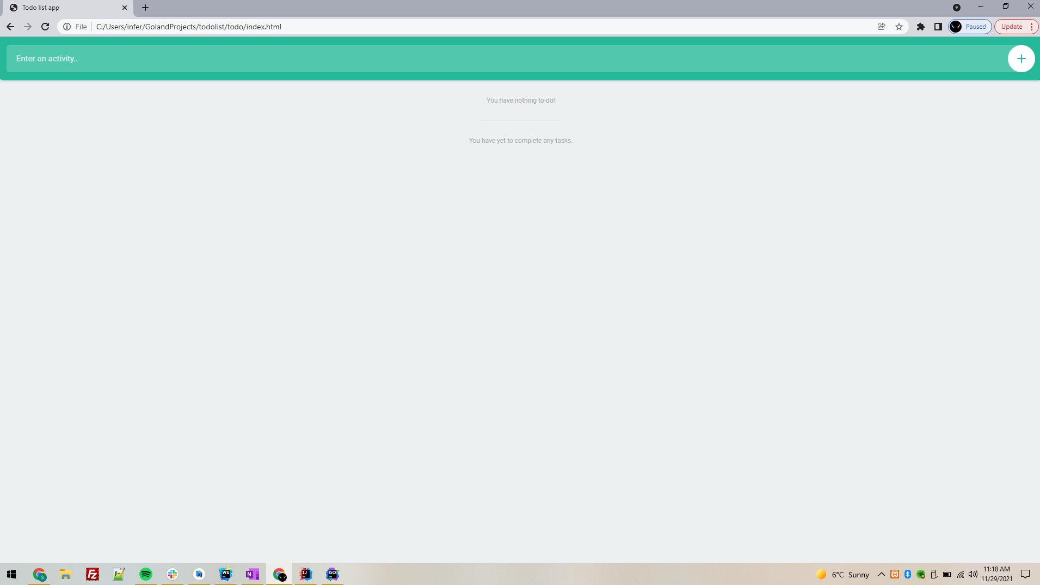
To-Do List App (Front-End)

Slide 19
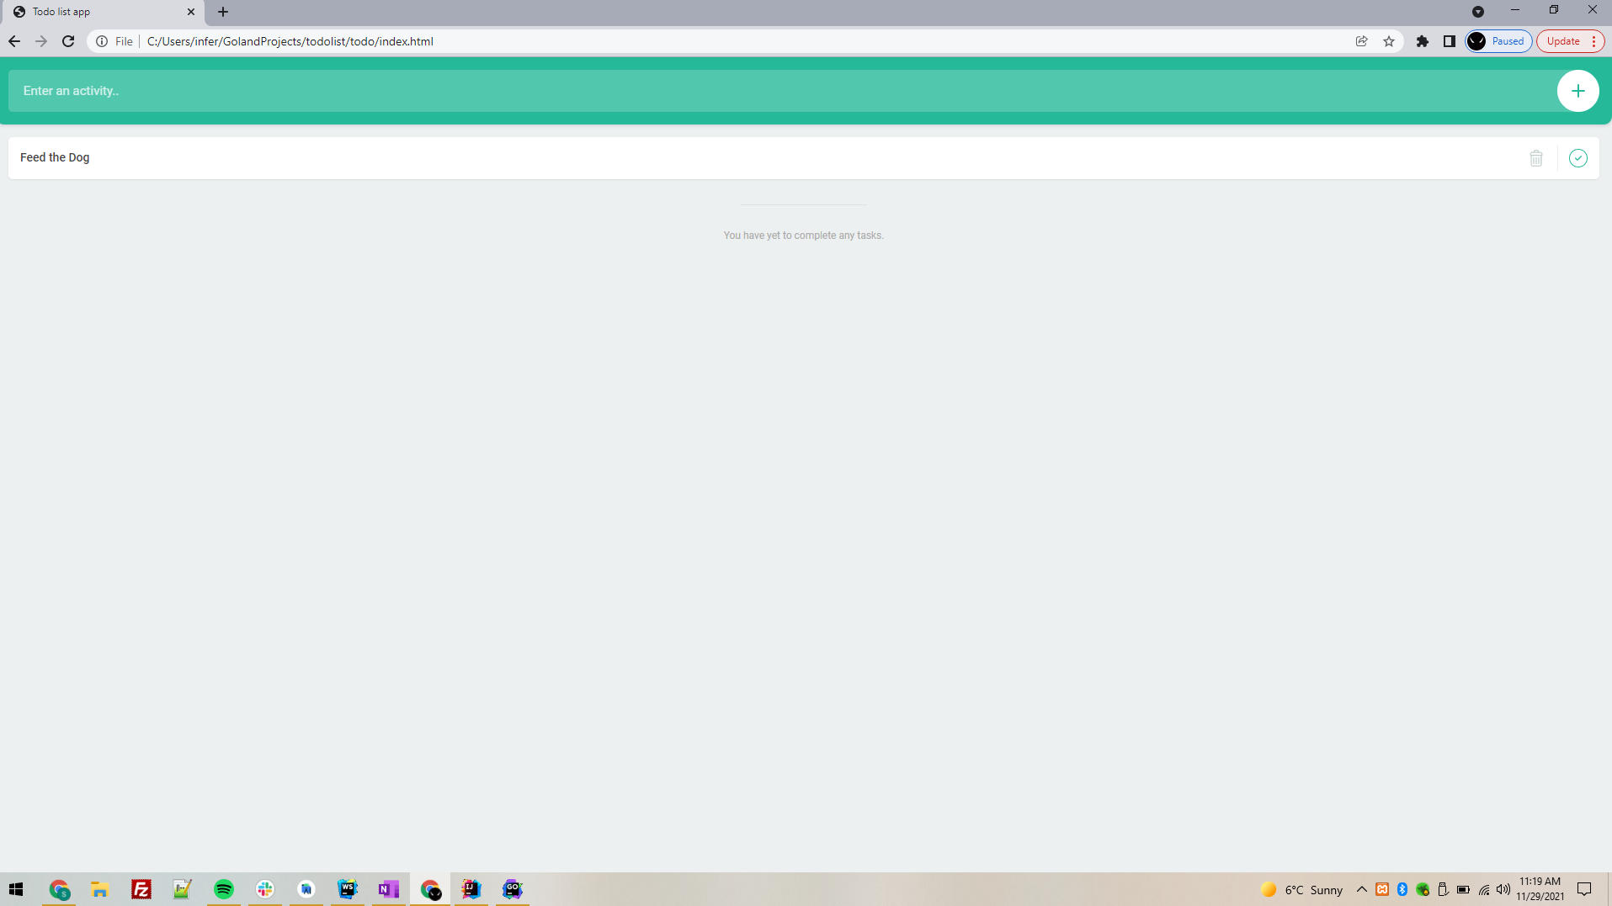
To-Do List App (Front-End)

Slide 20
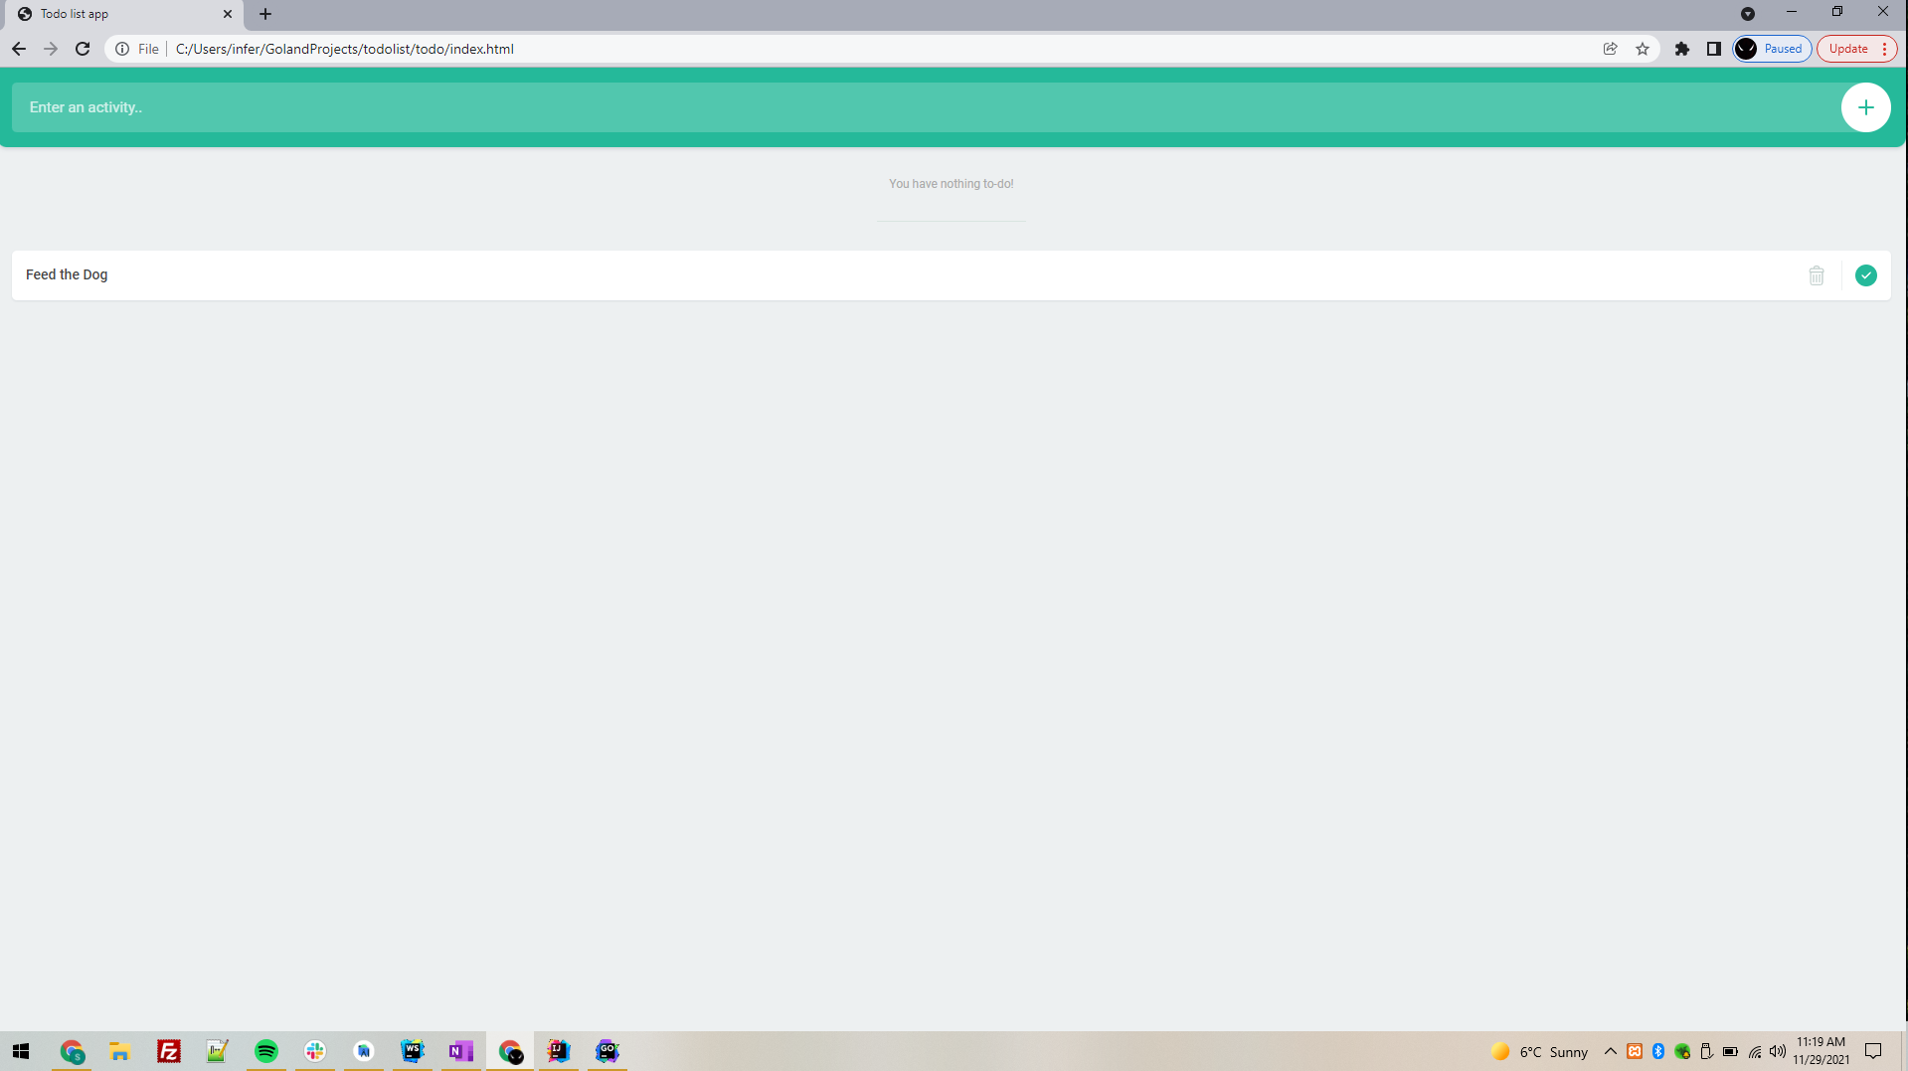
To-Do List App (Front-End)

Slide 21
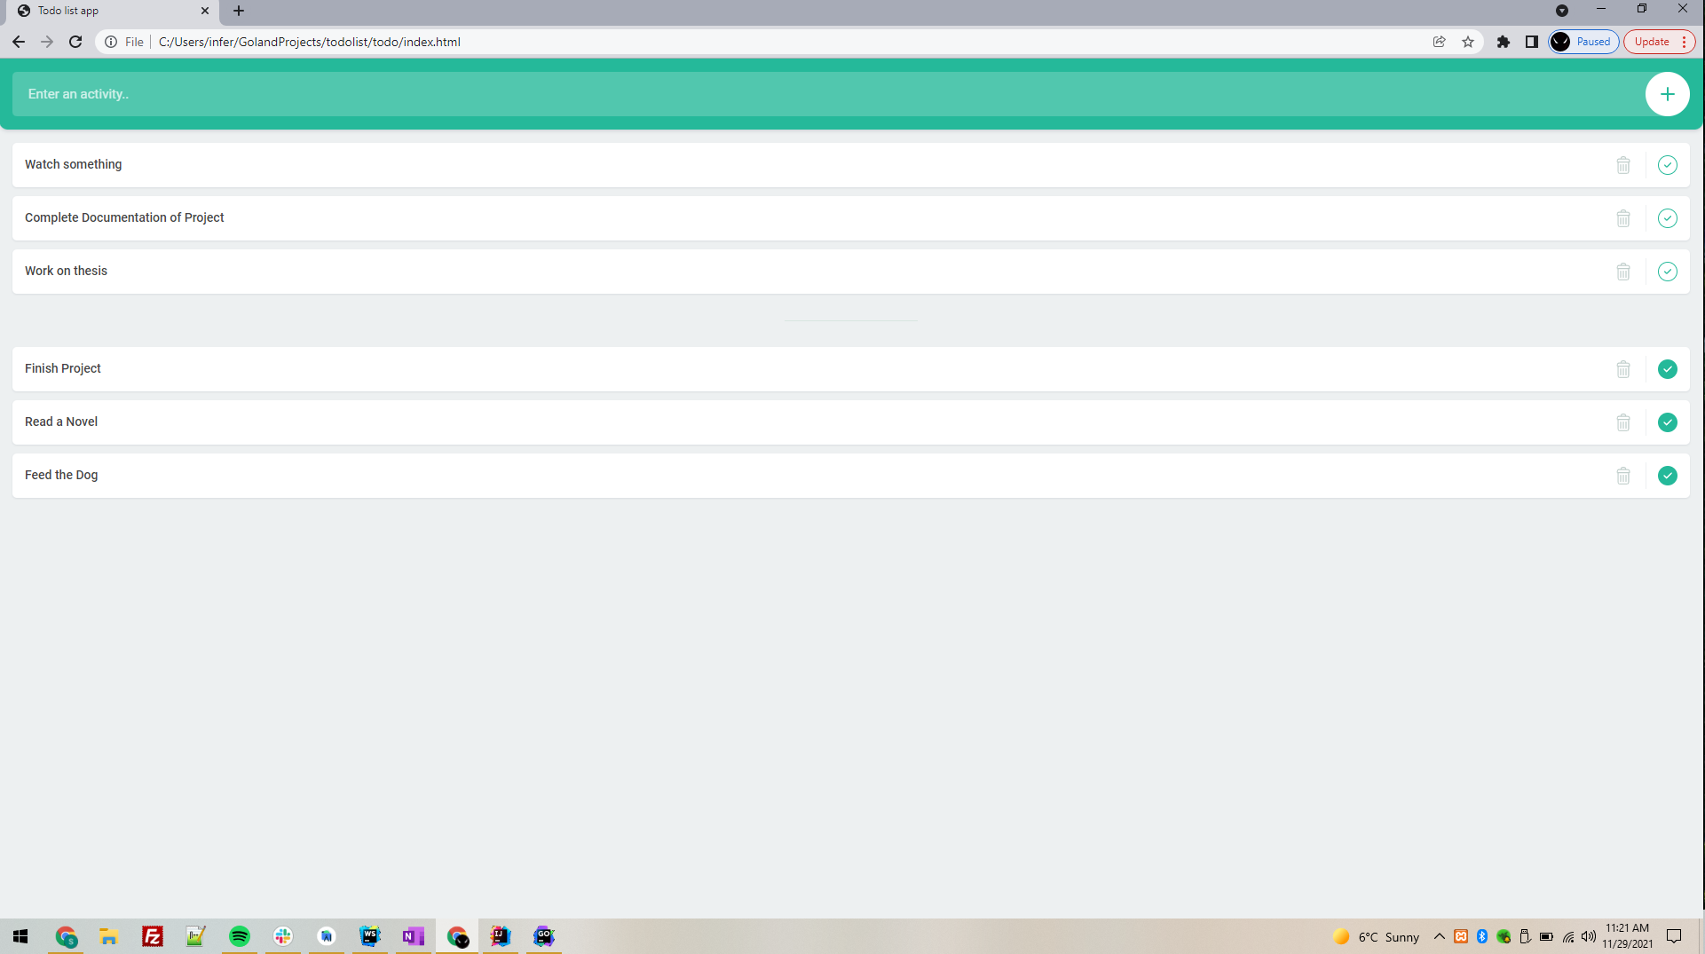
To-Do List App (Front-End)

Slide 22
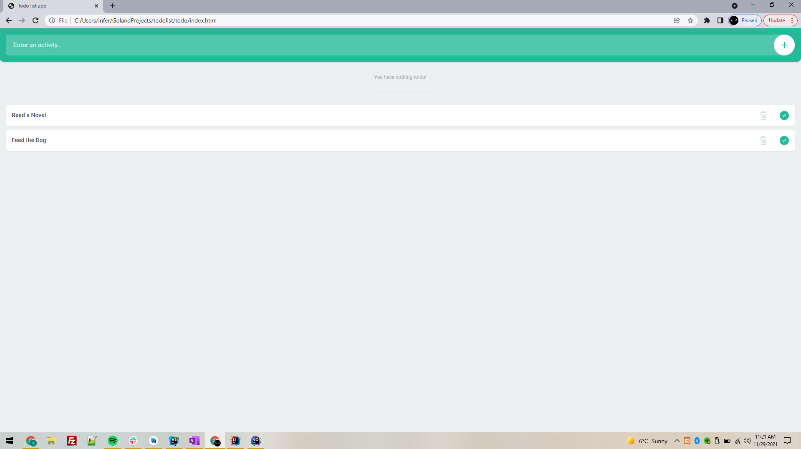
To-Do List App (Front-End)

Slide 23
Future Enhancements -
Build the feature to add reminders for the To-Do tasks.
Integrate the To-Do List app with Google calendar.

Slide 24
Thank You!
Any Questions?

